Slide 1

A Scalable Language

Slide 2
Static - Object Oriented & Functional Language
Static: Types checked before
run-time
Pure Object Oriented Language: Everything is an object
Functional Language: Supports functional paradigms
( Immutability, Lazy Evaluation, Higher Order Functions, etc.)

Slide 3
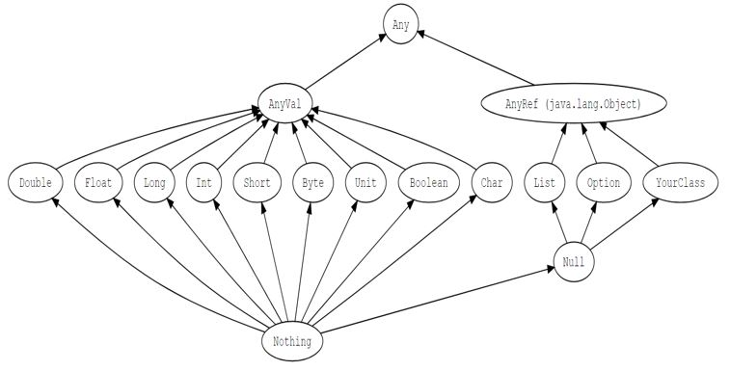
Scala Type Hierarchy

Slide 4
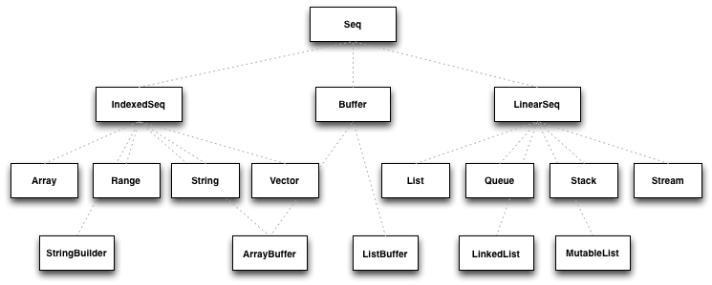
Collections Hierarchy

Slide 5
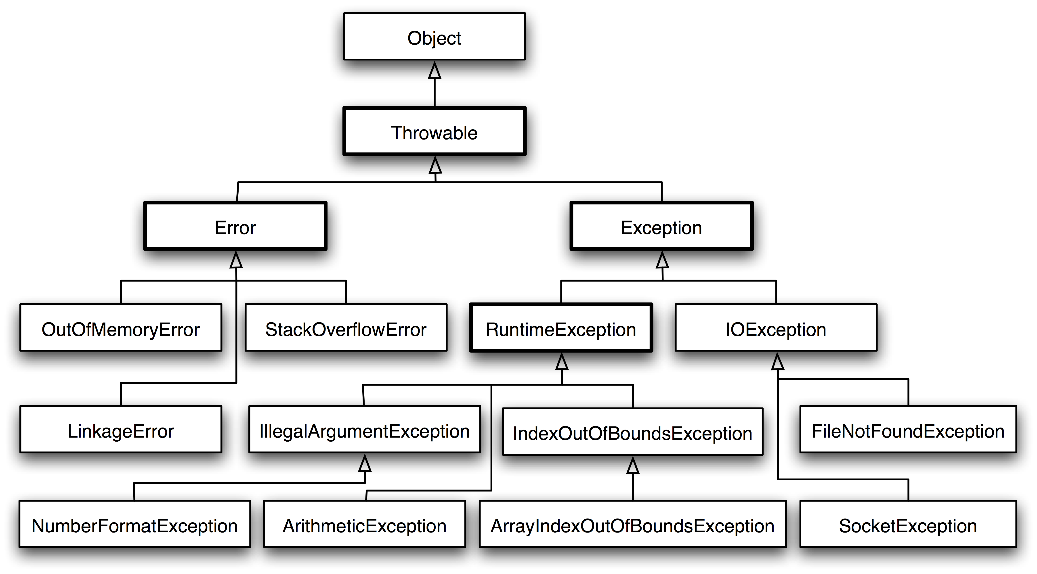
Throwable Hierarchy

Slide 6
The interactive build tool: sbt
Native support for compiling Scala code
Define your tasks in Scala
Run them in parallel from sbt's interactive shell
Continuous compilation, testing, and deployment
Dependency management
Integration with the Scala interpreter for rapid iteration and debugging

